Slide 1

Self-Relevance Predicts the Aesthetic Appeal of Real and Synthetic Artworks Generated via Neural Style Transfer
Group 8：邱志鹏、倪凤敏、吴雨欣、韩奕
Reported by：邱志鹏
Report date：June 19, 2024
Vessel, E. A., Pasqualette, L., Uran, C., Koldehoff, S., Bignardi, G., & Vinck, M. (2023). Self-relevance predicts the aesthetic appeal of real and synthetic artworks generated via neural style transfer. Psychological Science, 34(9), 1007-1023. https://doi.org/10.1177/09567976231188107

Slide 2
Introduction
Methods
Summary of Repeatability Results
Discussion
Conclusion
CONTENTS

Slide 3
Introduction
Part 1

Slide 4
Introduction
Methods
Summary of Repeatability Results
Discussion
Conclusion
Part one
Part two
Part three
Part four
Part five
What determines an artwork’ s aesthetic appeal and differences in aesthetic experiences between individuals?
“Shared taste” accounts for only 10% to 20% of reliable variance in aesthetic ratings of artworks.(Leder et al, 2016; Vessel et al, 2018)
Several frameworks for understanding aesthetic experiences suggest that self-relevance is central to aesthetic evaluations of artwork.（Pelowski et al , 2017）
Notes:
对艺术作品的体验会给我们带来不同的感受，这种感受的不同可能是由艺术作品的固有属性带来的，在不同的个体之间存在一种相似的审美标准，比如某些艺术作品，不论观众的个人经历或背景如何，都会被认为是具有吸引力的；但是这种共同品味只能解释审美不同的10%-20%左右，更大一部分的审美吸引力与自我相关性有关，也就是说，艺术作品与个人经历的关联性对个人的审美吸引力有更大的影响。自我相关性反映了某物和个人自我图式的相关程度，它可能是艺术作品审美评价的核心。

Slide 5
Introduction
Methods
Summary of Repeatability Results
Discussion
Conclusion
Part one
Part two
Part three
Part four
Part five
The present study hypothesized that the aesthetic appeal of an artwork depends strongly on self-relevance.
Experiment 1: To observe the association between self-relevance and aesthetic ratings.
Experiment 2
the effect of self-relevance on the aesthetic appeal of artwork by using synthetic and self-relevant artworks created with deep neural networks.
the mediating role of familiarity between self-relevance and aesthetic appeal.
Experient 1A explores the relationship between self-relevance and aesthetic appeal.
Experient 1B replicates the findings of 1A online, further confirms the relationship between self-relevance and aesthetic appeal (moved and beauty).

Slide 6
Methods
Part 2

Slide 7
Introduction
Methods
Summary of Repeatability Results
Discussion
Conclusion
Part one
Part two
Part three
Part four
Part five
Experiment 1A
Participants
Stimuli
33 German-speaking participants
(age: M = 28.9 years, SD = 7.3)
Final N=32
01
The stimulus set consisted of 148 photos of visual artworks used in a previous study.(Vessel et al., 2018)
02
03
Procedure
Block 1 consisted of aesthetic ratings of all 148 artworks.
Block 2 consisted of self-relevance ratings of all 148 artworks
Blocks 3 and 4 were retest blocks for aesthetic ratings and self-relevance ratings, for a subset of 20 artworks.
Data analysis
04
Data were analyzed and visualized in the R programming environment Slider responses for both aesthetic appeal and self-relevance were coded on a scale from 0 to 1.
Notes:
实验 1A该实验旨在探讨自我相关性与审美吸引力之间的关系。研究方法如下：被试。33 名德国籍成年人（29 名女性，4 名男性）参与实验。被试年龄在 18-55 岁之间，视力正常或矫正后正常，无已知神经系统疾病。。一个观察者的平均信度得分低于0.5的临界值，因此从进一步的分析中删除(最终N = 32)。
刺激材料是148 张视觉艺术作品的照片，来自之前的实验 (Vessel et al., 2018)。
实验程序：实验分为四个部分。第一部分：被试对 148 张艺术作品的美感进行评分。第二部分 被试对 148 张艺术作品的自我相关性进行评分。第三部分和第四部分 分别对 20 张艺术作品进行重复的美感和自我相关性评分，以评估测试-重测信度。每次试验开始时，被试会看到艺术作品 5 秒，然后进行评分。
数据分析：使用线性混合模型 (LMM) 分析美感和自我相关性评分之间的关系。使用方差分解方法分析图像特征和自我相关性对美感评分的贡献。使用皮尔逊相关系数计算观察者之间的共享美感和共享自我相关性。

Slide 8



Introduction
Methods
Summary of Repeatability Results
Discussion
Conclusion
Part one
Part two
Part three
Part four
Part five
Ratings for self-relevance
A
Ratings for aesthetic appeal
Participants were asked to rate how self-relevant an artwork was for them using a continuous response scale.
Self-relevance was defined as"the extent to which something relates to you, your experiences, or your identity. These are the things and events that define you as a person."
Participants were asked to rate how aesthetically pleasing an image was for them using a continuous response scale.
Participants were encouraged to answer according to their own aesthetic evaluation on the basis of how "moved" they were by the paintings.
B
means low
means high
Notes:
1.被试被要求用一个连续的反应量表来评价一张图片对他们的审美吸引力。被试被鼓励根据自己对画作的“感动”程度，根据自己的审美评价来回答问题。 被试被要求使用一个连续的反应量表来评价一件艺术品对他们的自我相关性。自我相关性被定义为“某件事与你、你的经历或你的身份相关的程度”。这些是将你定义为一个人的事物和事件。”

Slide 9
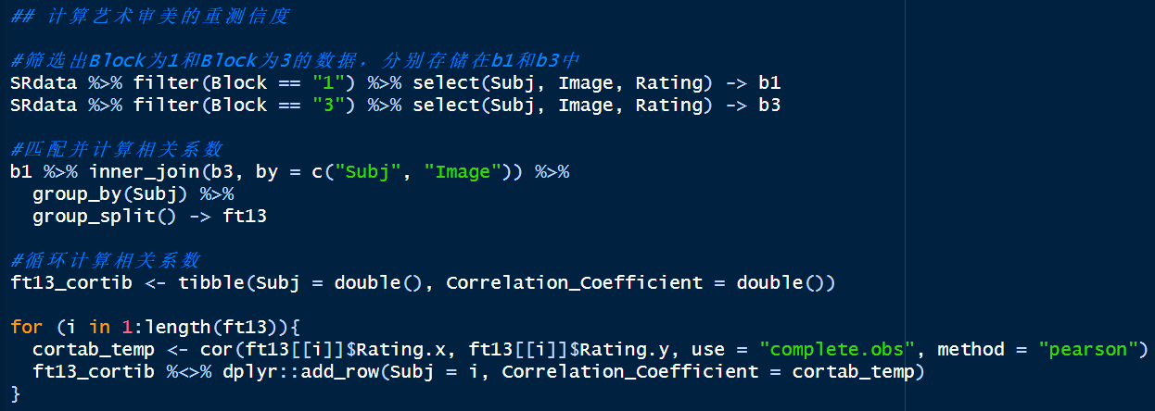
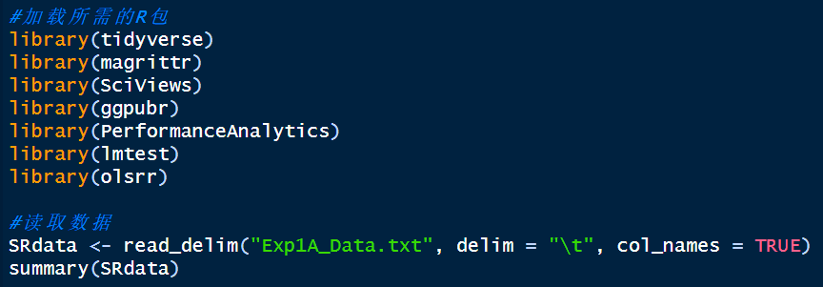
Introduction
Methods
Summary of Repeatability Results
Discussion
Conclusion
Part one
Part two
Part three
Part four
Part five
Experiment 1A---Code Reproduction
Exp1A_Reliability.R
Notes:
计算实验1A的重测信度分数

Slide 10
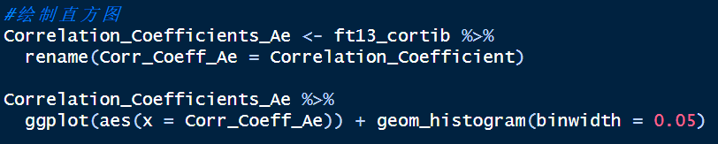
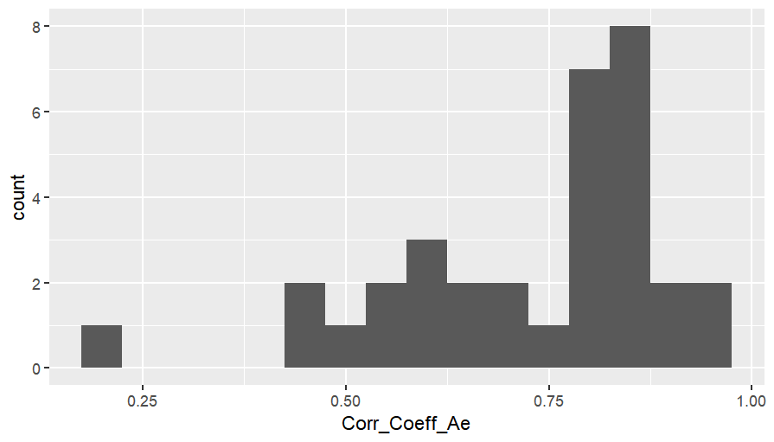
Introduction
Methods
Summary of Repeatability Results
Discussion
Conclusion
Part one
Part two
Part three
Part four
Part five
Experiment 1A---Code Reproduction

Slide 11
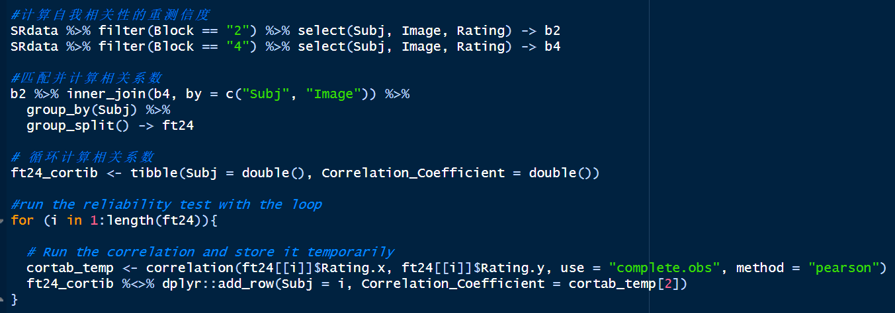
Introduction
Methods
Summary of Repeatability Results
Discussion
Conclusion
Part one
Part two
Part three
Part four
Part five
Experiment 1A---Code Reproduction

Slide 12
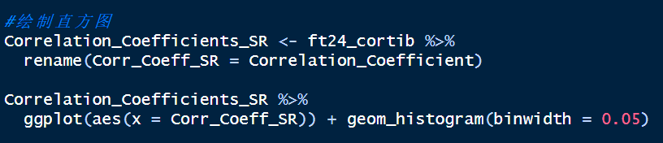
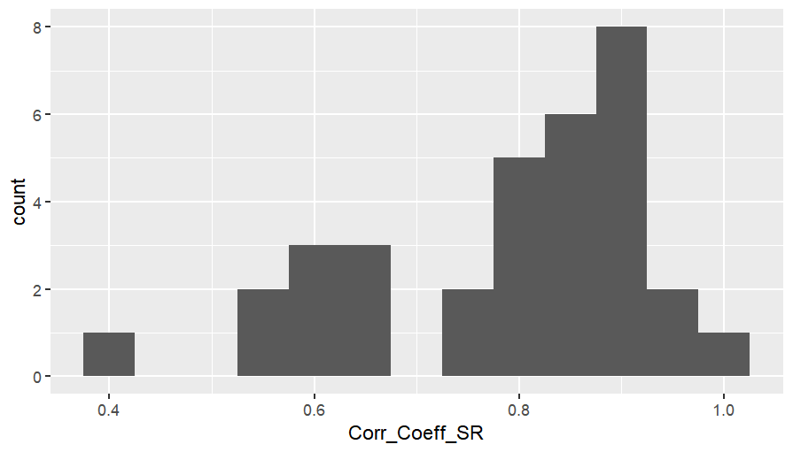
Introduction
Methods
Summary of Repeatability Results
Discussion
Conclusion
Part one
Part two
Part three
Part four
Part five
Experiment 1A---Code Reproduction

Slide 13
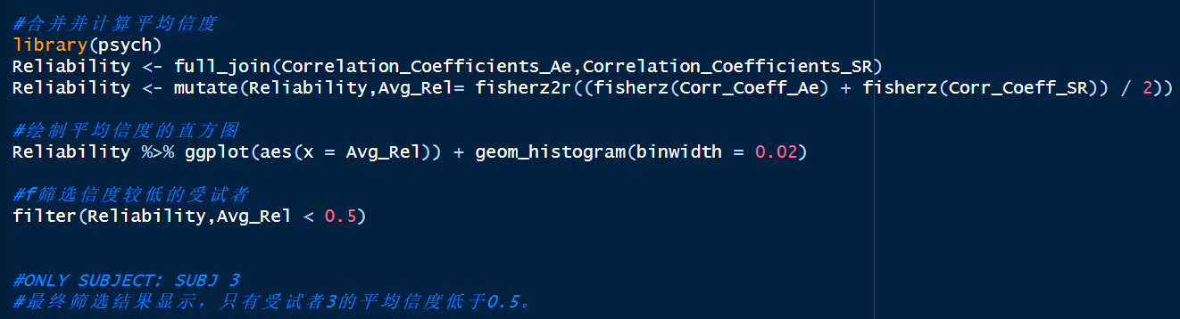
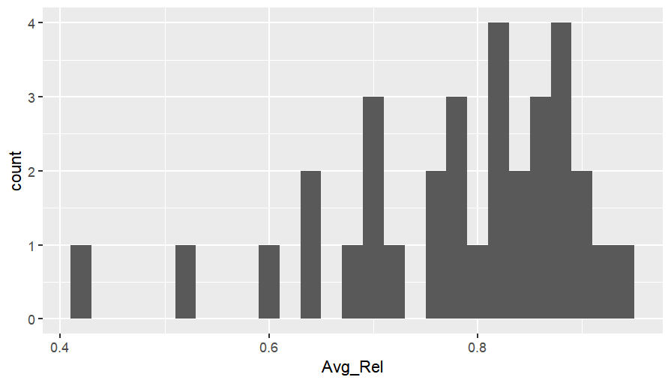
Introduction
Methods
Summary of Repeatability Results
Discussion
Conclusion
Part one
Part two
Part three
Part four
Part five
Experiment 1A---Code Reproduction

Slide 14
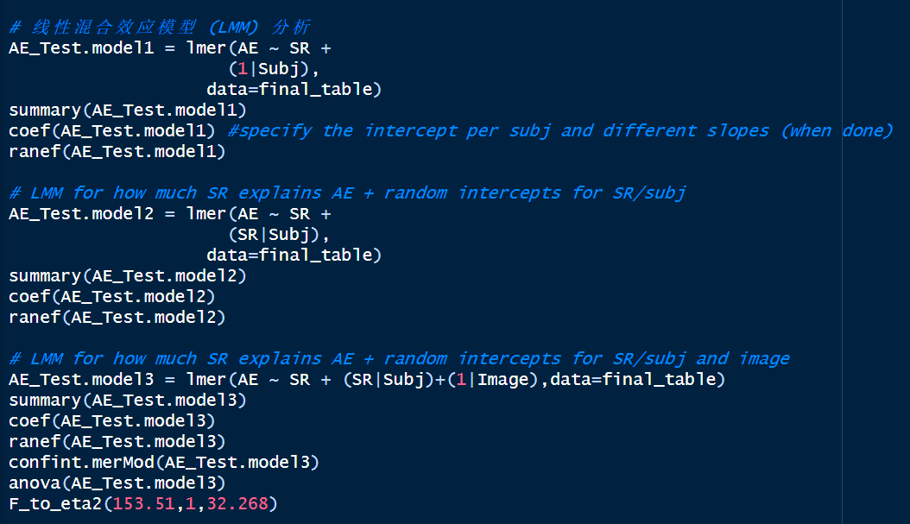
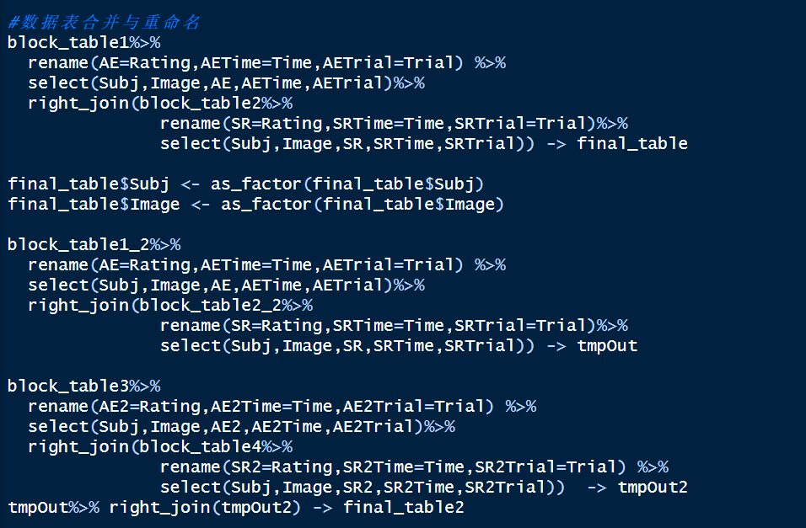
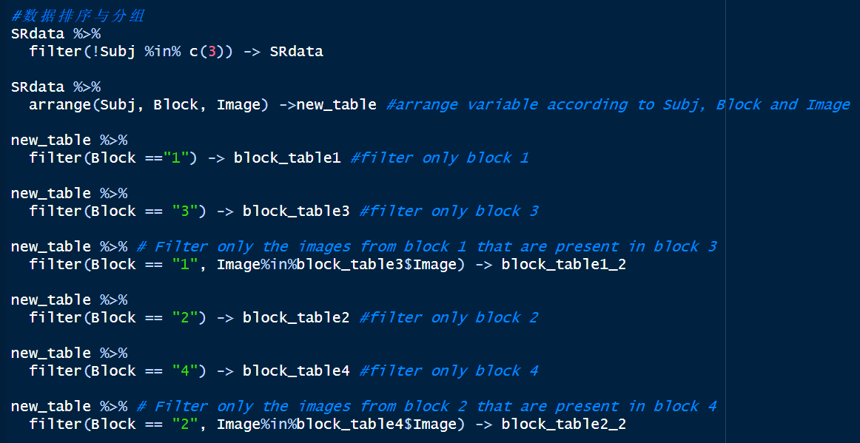
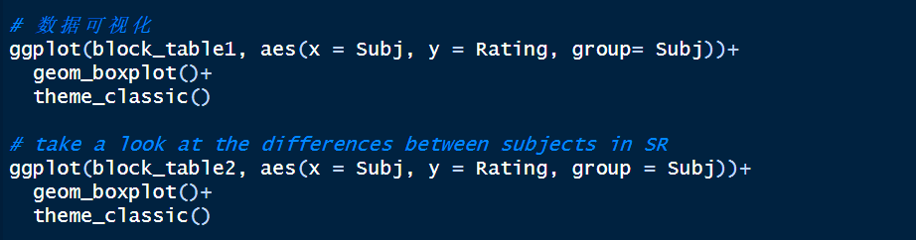
Introduction
Methods
Summary of Repeatability Results
Discussion
Conclusion
Part one
Part two
Part three
Part four
Part five
Experiment 1A---Code Reproduction
Exp1A_LinMixedModels.R
Notes:
该代码首先读取数据并进行初步处理，包括过滤低可靠性参与者、排序和分组数据。然后，通过一系列线性混合效应模型（LMM）分析自我相关性评分如何预测美感评分，并通过绘图展示不同参与者和总体的评分关系。最后，比较不同模型的效果，并分析重测数据。

Slide 15
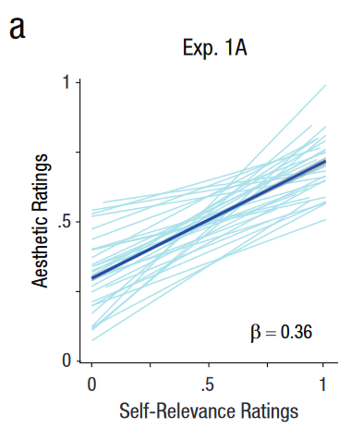
Introduction
Methods
Summary of Repeatability Results
Discussion
Conclusion
Part one
Part two
Part three
Part four
Part five
Experiment 1A---Code Reproduction
Exp1A_LinMixedModels.R
Notes:
该代码首先读取数据并进行初步处理，包括过滤低可靠性参与者、排序和分组数据。然后，通过一系列线性混合效应模型（LMM）分析自我相关性评分如何预测美感评分，并通过绘图展示不同参与者和总体的评分关系。最后，比较不同模型的效果，并分析重测数据。

Slide 16
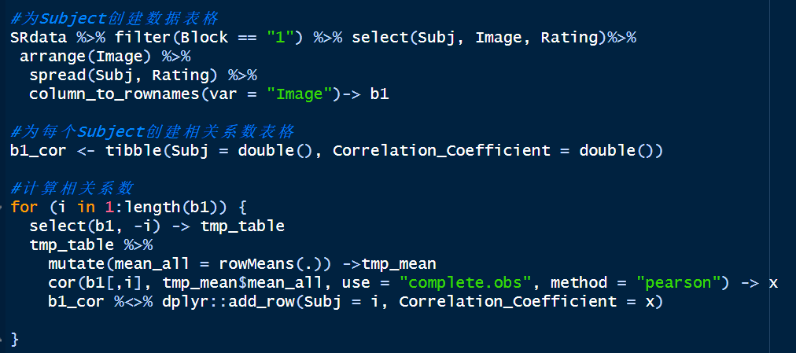
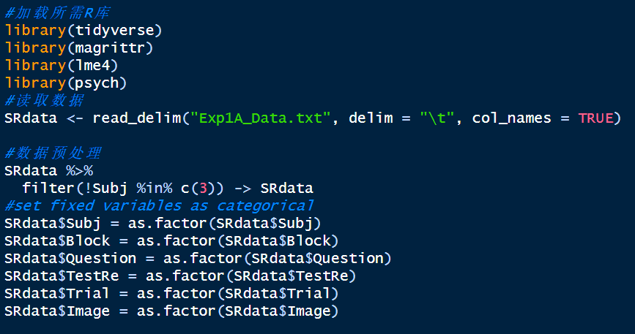
Introduction
Methods
Summary of Repeatability Results
Discussion
Conclusion
Part one
Part two
Part three
Part four
Part five
Experiment 1A---Code Reproduction
Exp1A_MM1.R——MM1 FOR AESTHETIC APPEAL
Notes:
为实验1A计算跨观察者协议度量和方差划分

Slide 17
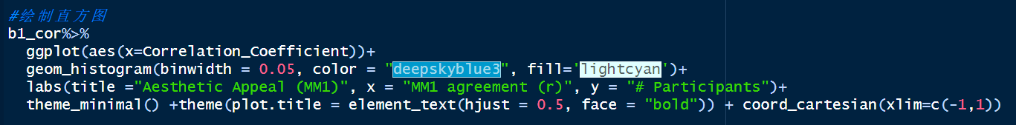
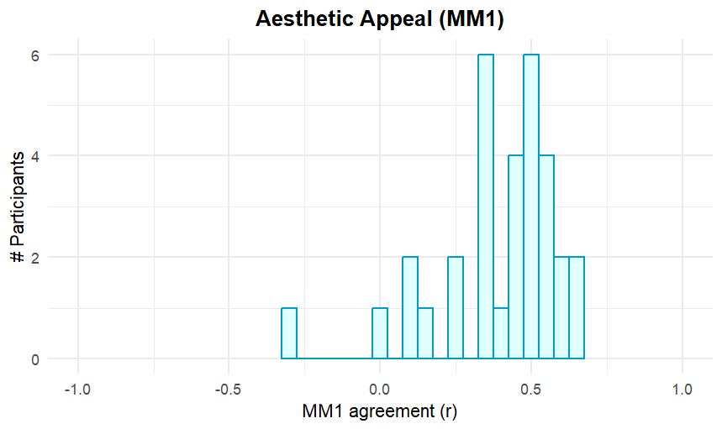
Introduction
Methods
Summary of Repeatability Results
Discussion
Conclusion
Part one
Part two
Part three
Part four
Part five
Experiment 1A---Code Reproduction

Slide 18
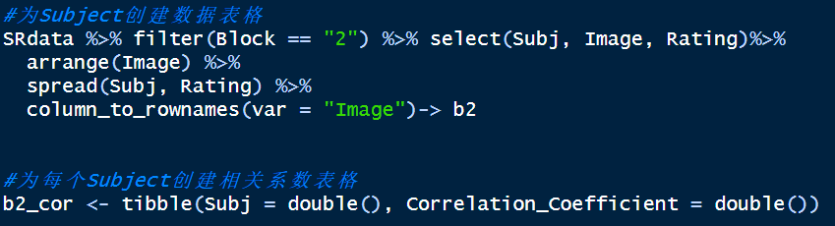
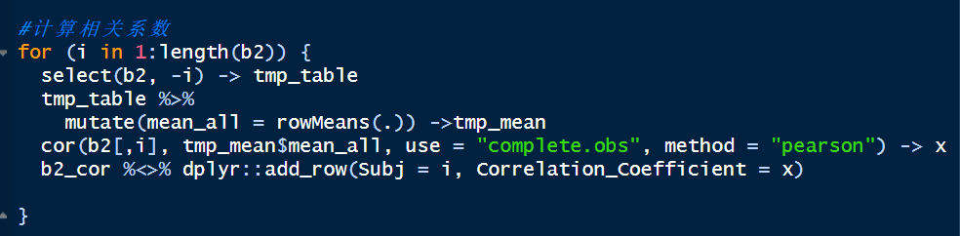
Introduction
Methods
Summary of Repeatability Results
Discussion
Conclusion
Part one
Part two
Part three
Part four
Part five
Experiment 1A---Code Reproduction
Exp1A_MM1.R——MM1 FOR SELF-RELEVANCE

Slide 19
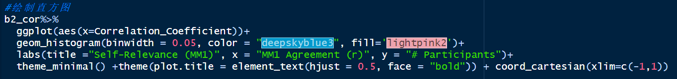
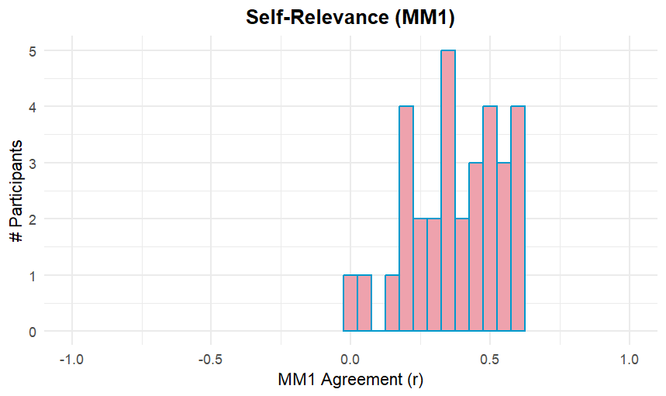
Introduction
Methods
Summary of Repeatability Results
Discussion
Conclusion
Part one
Part two
Part three
Part four
Part five
Experiment 1A---Code Reproduction

Slide 20
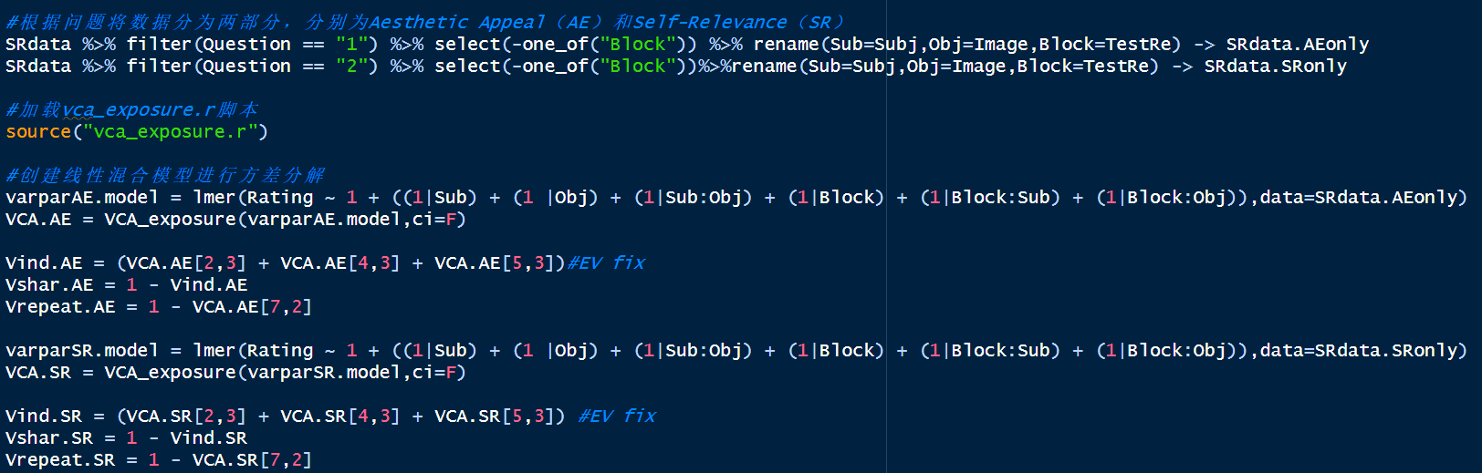
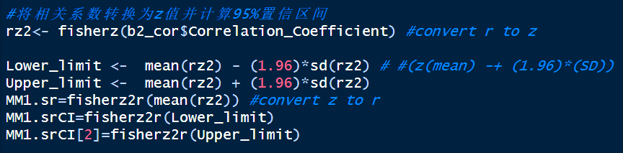
Introduction
Methods
Summary of Repeatability Results
Discussion
Conclusion
Part one
Part two
Part three
Part four
Part five
Experiment 1A---Code Reproduction

Slide 21
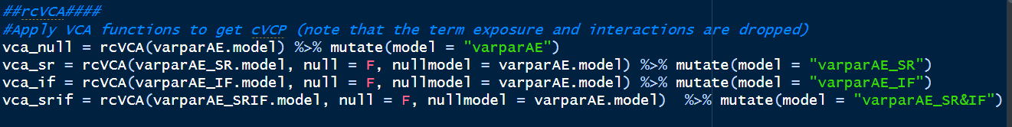
Introduction
Methods
Summary of Repeatability Results
Discussion
Conclusion
Part one
Part two
Part three
Part four
Part five
Experiment 1A---Code Reproduction
Exp1A_rcVCA_DA.R

Slide 22
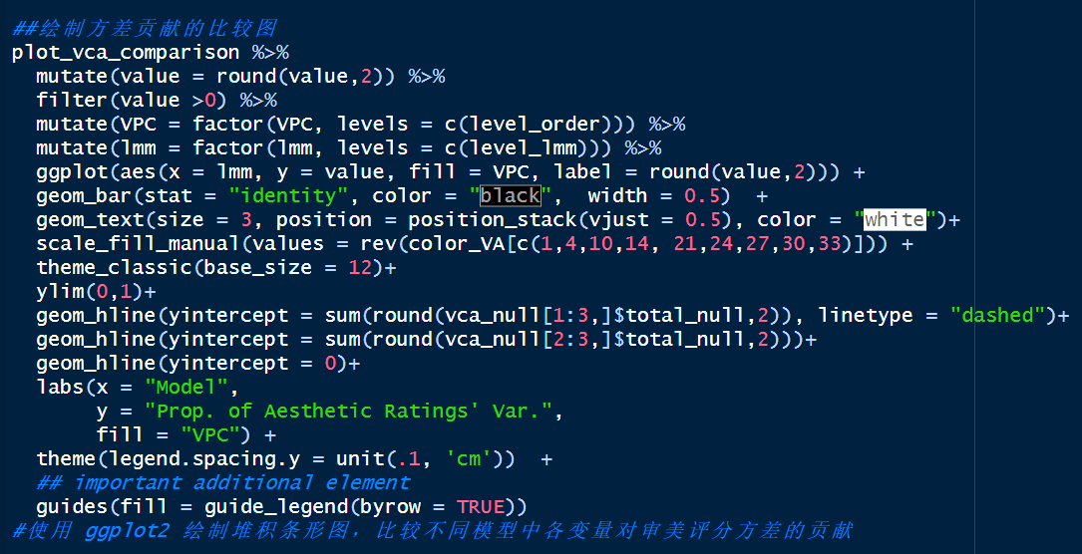
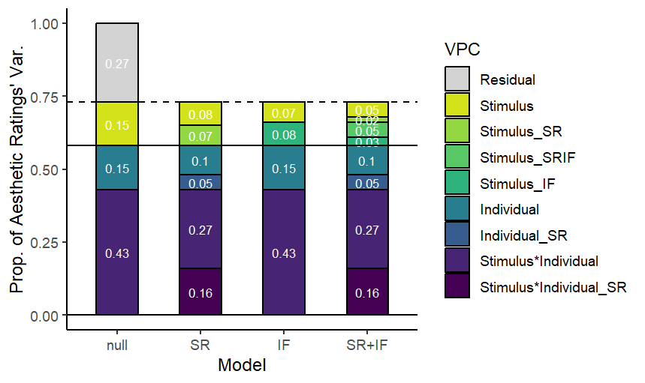
Introduction
Methods
Summary of Repeatability Results
Discussion
Conclusion
Part one
Part two
Part three
Part four
Part five
Experiment 1A---Code Reproduction

Slide 23
Introduction
Methods
Summary of Repeatability Results
Discussion
Conclusion
Part one
Part two
Part three
Part four
Part five
Experiment 1B
Stimuli
Each participant viewed 42 artworks, which were a subset of those used in Experiment 1A.
Participants
208 participants
( age: M =27.3 years, SD = 9.3)
01
02
03
Procedure
04
Data analysis
Block 1 : participants viewed each image for 5s, followed by a screen on which they were required to rate each image on 10 different questions.
Block 2 : participants saw each artwork again in a new random order and responded to the question, “How self-relevant is the image to you?”
Data were analyzed and visualized using R (R Core Team, 2022). Slider responses were initially collected on a 400-point interval scale and subsequently recoded to values between 0 and 1.
Notes:
在这里具体介绍实验1B的研究内容：这部分实验是对实验1A的重复研究。研究者在线上招募了208名被试来进行实验。每名被试观看42件艺术作品，这些作品是实验1A中艺术学家认为具有代表性的一部分作品。分为两个组块，block1中，被试观看每张图片5s，然后要求他们在屏幕上出现10个不同的问题上对每张图片进行评分，主要是审美吸引力的评分，被试通过鼠标点击连续滑块条上的一个位置对每个问题进行反应。当十个问题全部回答完毕之后，被试点击下一步按钮进行下一个试次。在这里主要关注两个问题，也就是这些图像在多大程度上感到了美感和受到了感动。block2：被试以随机的顺序再次看到42件作品，并回答问题：对你来说，图像的自我相关性如何，同样也是在图像下方呈现这个单一问题和连续反应量表，当被试回答完毕之后，可以点击下一步按钮进行下一个试次。在后续的数据分析中，审美吸引力和自我相关性的评分会从原本的0-400分重新编码成0-1之间的数字

Slide 24
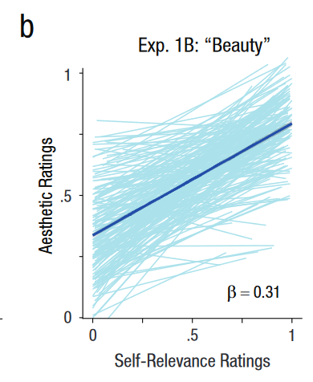
Introduction
Methods
Summary of Repeatability Results
Discussion
Conclusion
Part one
Part two
Part three
Part four
Part five
Experiment 1B---Code Reproduction
Notes:
实验1B主要是通过线性混合模型分析来个体的自我相关性评分是否能够预测两种审美吸引力，即美感和被感动。在这一部分，作者分别构建了四个模型，即模型1：仅包含参与者特定的截距；模型2：包含参与者特定的截距和斜率；模型3：包含参与者特定的截距和斜率，以及图像特定的截距；模型4：包含参与者特定的截距和斜率，以及图像特定的截距和斜率。通过比较AIC值来确定最佳模型，帮助更好理解审美吸引力与自我相关性之间的关系。

Slide 25
Introduction
Methods
Summary of Repeatability Results
Discussion
Conclusion
Part one
Part two
Part three
Part four
Part five
Experiment 2
Stimuli
Participants
80 artworks, 20 in each of four conditions
Real Artworks
Self-Relevant Artworks
Other-Relevant Artworks
Generated Control Artworks
40 participants
(age: range = 18 - 55 years,
M =27.3 ± 9.3 years)
01
02
03
Procedure
Data analysis
04
Block 1：Rating the full set of 80 artworks for aesthetic appeal
Block 2： Rating the full set of artworks for aesthetic appeal a second time to assess test-retest reliability.
Block 3： Rating the full set of artworks for self-relevance.
Block 4： Rating the full set of artworks for familiarity.
Data were analyzed and visualized using R. Pearson correlation; Linear mixed model (LMM)
Notes:
被试：52人（M =27.3 ± 9.3 years）参加，但45人完成，排除reliability的r<0.5的，数据分析中用到的Final N为40。 刺激材料：风格转移生成（不太清楚如何表达，下一张PPT是4种刺激图片，分别为：自我相关、他人相关、控制、真实。 任务：每个被试完成4个block，block 1 审美吸引力，block 2 审美吸引力评级重测，block 3 自我相关性评级，block 4 熟悉性评级

Slide 26
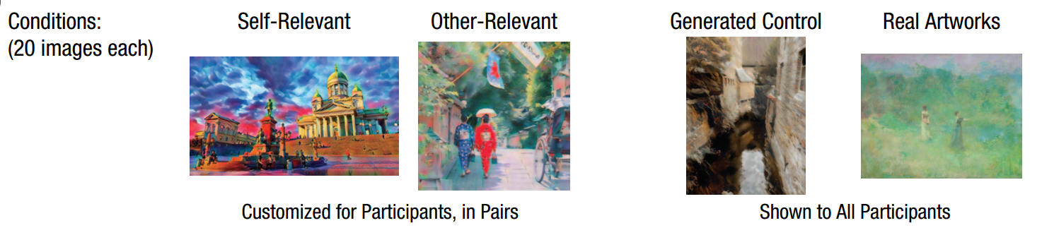
Introduction
Methods
Summary of Repeatability Results
Discussion
Conclusion
Part one
Part two
Part three
Part four
Part five
Style transfer
Notes:
在深度卷积神经网络编码的内容图像的分层特征表示(卷积层)上匹配输入样式的低级和中级特征统计。该网络首先在编码器网络的特征空间中对内容和样式图像进行编码，该编码器网络由预训练的VGG-19 深度卷积神经网络的前几层组成。然后将特征映射馈送到自适应实例规范化层，该层将内容特征映射的均值和方差与样式特征映射的均值和方差对齐，以产生一组目标特征映射。最后，训练一个解码器(随机初始化)从目标特征映射映射回图像空间，从而生成风格化的图像。

Slide 27
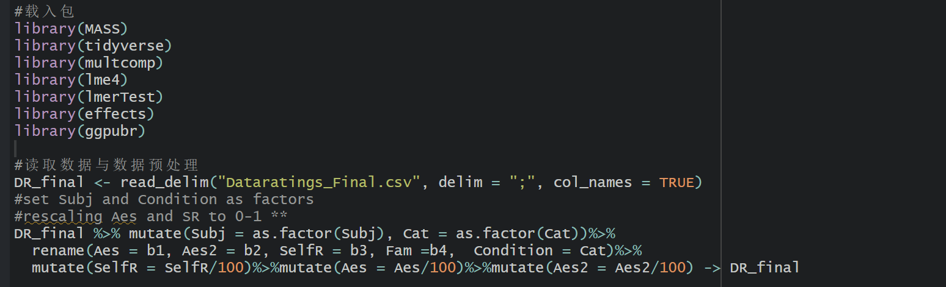
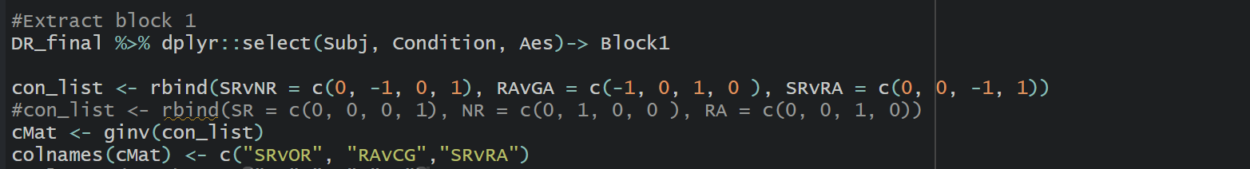
Introduction
Methods
Summary of Repeatability Results
Discussion
Conclusion
Part one
Part two
Part three
Part four
Part five
Experiment 2 ---Code Reproduction
Effect of stimulus condition on aesthetic appeal
Notes:
计算4种不同图片的审美吸引力评级的差异

Slide 28
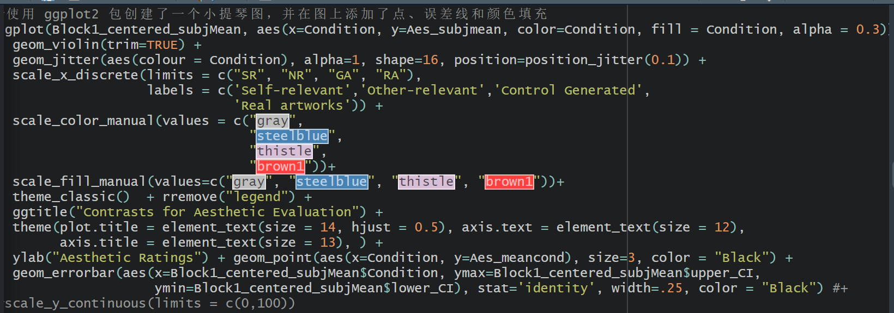
Introduction
Methods
Summary of Repeatability Results
Discussion
Conclusion
Part one
Part two
Part three
Part four
Part five
Experiment 2 ---Code Reproduction

Slide 29
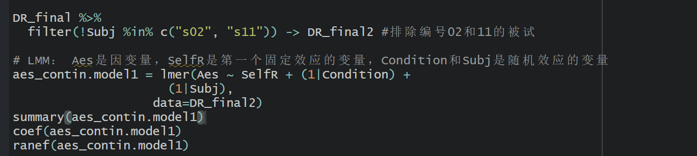
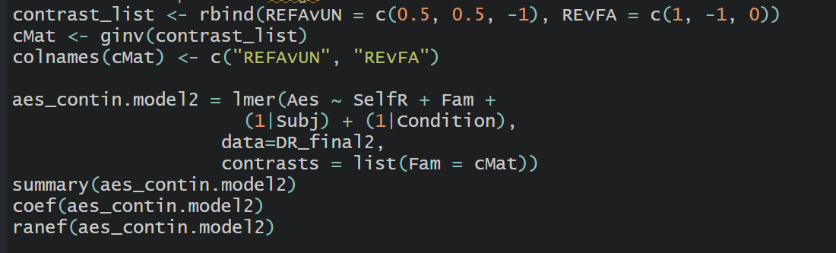
Introduction
Methods
Summary of Repeatability Results
Discussion
Conclusion
Part one
Part two
Part three
Part four
Part five
Experiment 2 ---Code Reproduction
Predicting aesthetic ratings from ratings of self-relevance and familiarity.
Model 1
Model 2
Notes:
线性混合模型，三个model 都是预测审美吸引力评级的，model 1 是自我相关性为固定效应变量、condition和subject是随机效应变量；model 2 是自我相关性和熟悉性为固定效应变量，condition和subject是随机效应变量，

Slide 30
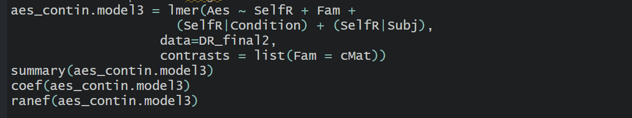
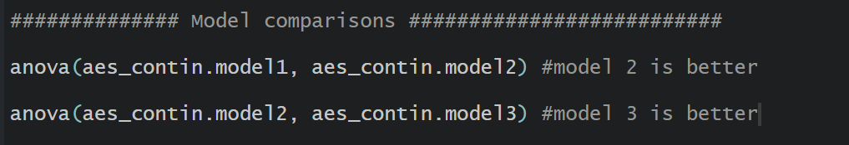
Introduction
Methods
Summary of Repeatability Results
Discussion
Conclusion
Part one
Part two
Part three
Part four
Part five
Experiment 2 ---Code Reproduction
Model 3
Notes:
model 3是自我相关性和熟悉性为固定效应变量，SelfR分别在Condition和Subj水平上作为随机效应。模型比较，发现3更好

Slide 31
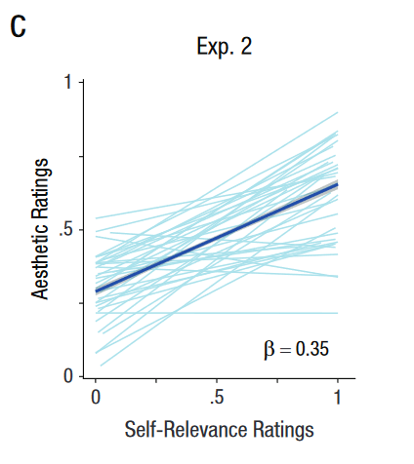
Introduction
Methods
Summary of Repeatability Results
Discussion
Conclusion
Part one
Part two
Part three
Part four
Part five
Experiment 2 ---Code Reproduction
Notes:
Model 3 最好，用model3 变量对审美评级的预测作用，绘制热图（见结果部分，一张是自我相关性预测审美评级，一张是熟悉性预测审美评级）

Slide 32
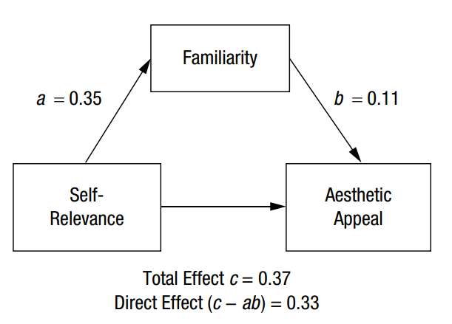
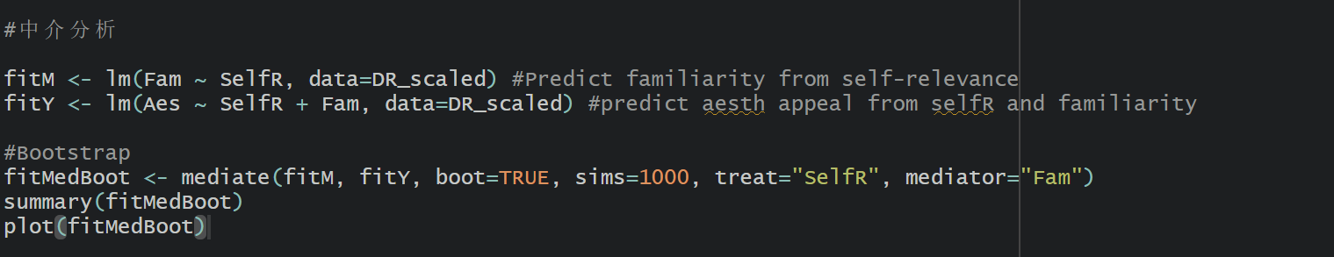
Introduction
Methods
Summary of Repeatability Results
Discussion
Conclusion
Part one
Part two
Part three
Part four
Part five
Experiment 2 ---Code Reproduction
Mediation analysis
Notes:
检验熟悉性在自我相关性和审美评级中的中介作用

Slide 33
Part 3
Summary of Repeatability Results

Slide 34
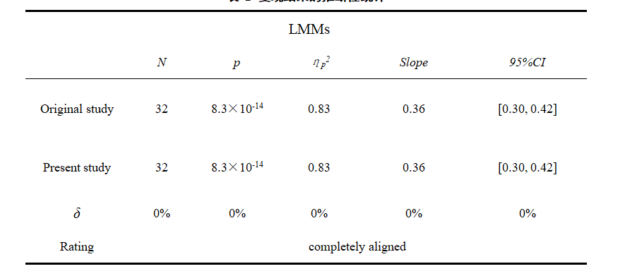
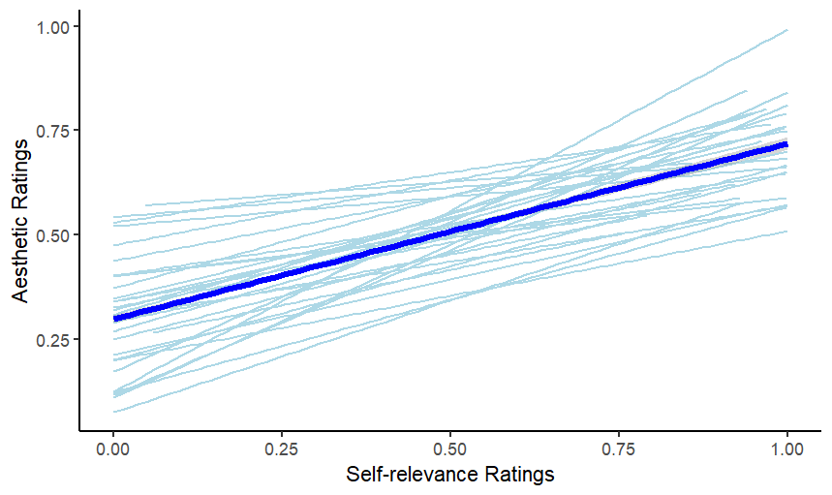
Introduction
Methods
Summary of Repeatability Results
Discussion
Conclusion
Part one
Part two
Part three
Part four
Part five
Experiment 1A---Results
Ratings of self-relevance strongly predict aesthetic appeal
Predicting aesthetic ratings from ratings of self-relevance and familiarity. For Experiment 1A, self-relevance ratings predicted that slope = 0.36 , 95% CI = [0.30,0.42], t(32.3) = 12.4, p = 8.3 × 10⁻¹⁴, η_{p}² =0.83(N = 32).
Notes:
审美吸引力的个人评级被建模为使用LMM的自我相关性的个人评级的函数，具有参与者特定的截距和斜率以及图像特定的截距。

Slide 35
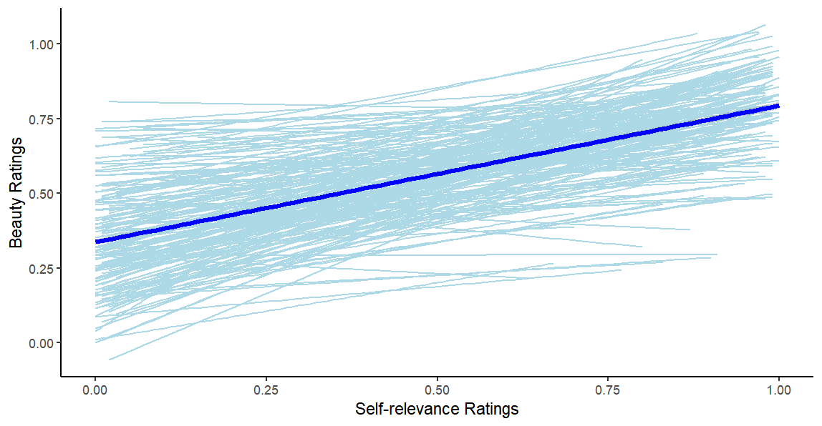
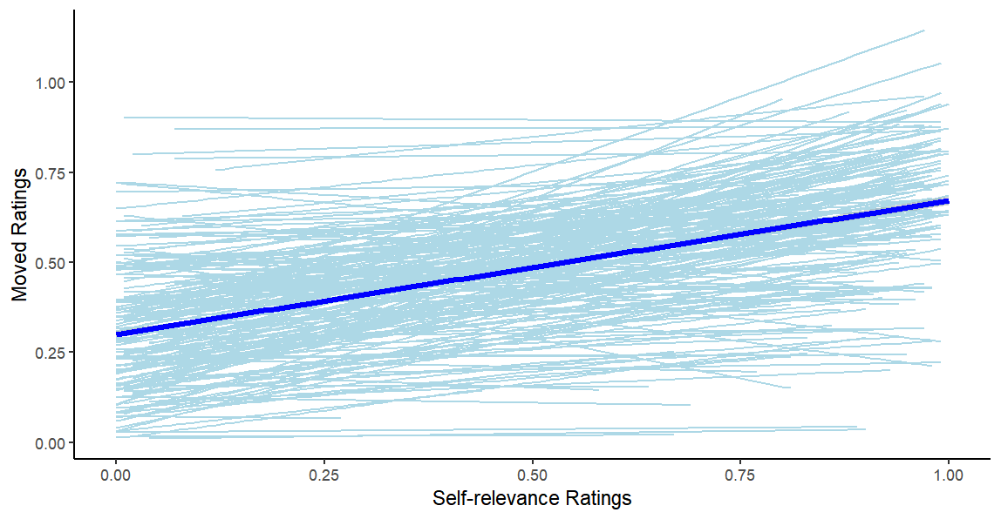
Introduction
Methods
Summary of Repeatability Results
Discussion
Conclusion
Part one
Part two
Part three
Part four
Part five
Experiment 1B---Results
Individual ratings of self-relevance were again strongly predictive of aesthetic ratings of both beauty, slope = 0.31, 95% CI = [0.28, 0.34], t (176.3) = 19.9, p = 4.7 × 10-47, η_{p}² = 0.69, and being moved, slope = 0.25, 95% CI = [0.22, 0.28], t (154.5) = 15.2, p = 1.4 × 10-32, η_{p}² = 0.60.
Notes:
线性混合模型结果表明，自我相关性的个体评分对美感和被感动这两种审美吸引力的评价均具有较强的预测作用

Slide 36
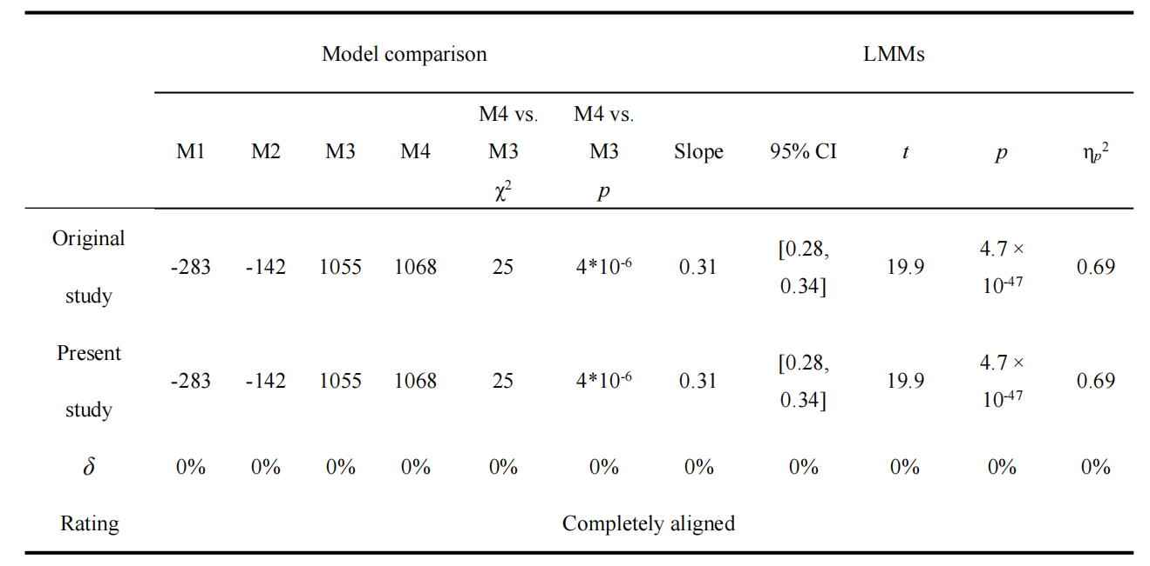
Introduction
Methods
Summary of Repeatability Results
Discussion
Conclusion
Part one
Part two
Part three
Part four
Part five
Experiment 1B---Results comparison
Experiment 1B association between self-relevance ratings and aesthetic appeal (feeling of beauty)
Notes:
这一页和下一页是复现结果和原文献汇报结果的比较，大部分结果都与原文报告的结果相同，但是下一页上，模型比较的P值与原文有出入

Slide 37
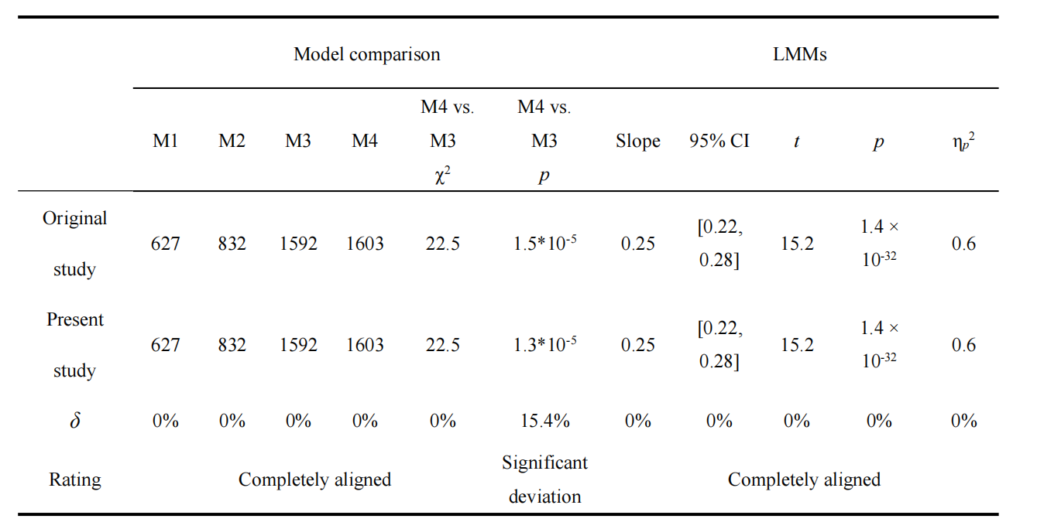
Introduction
Methods
Summary of Repeatability Results
Discussion
Conclusion
Part one
Part two
Part three
Part four
Part five
Experiment 1B---Results comparison
Experiment 1B association between self-relevance ratings and aesthetic appeal (feeling of being moved)

Slide 38
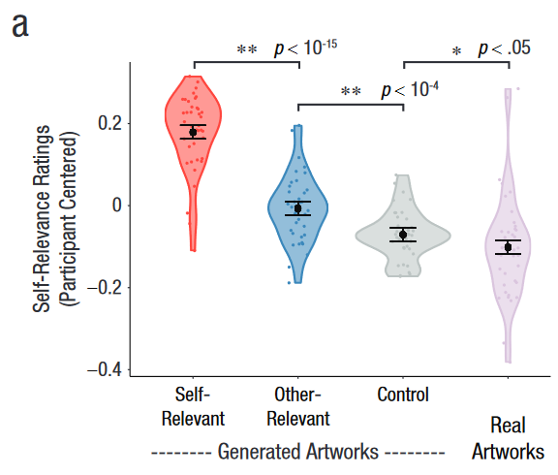
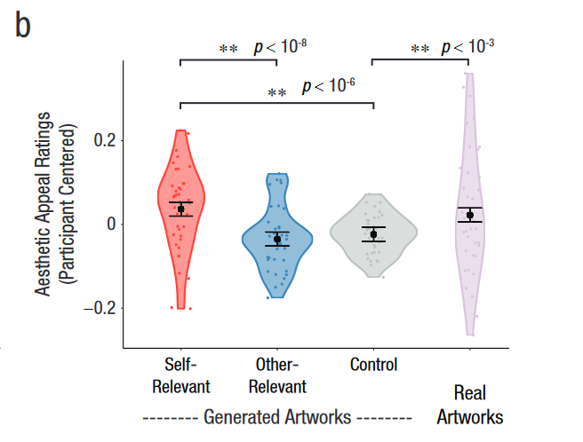
Introduction
Methods
Summary of Repeatability Results
Discussion
Conclusion
Part one
Part two
Part three
Part four
Part five
Experiment 2---Results
Notes:
这个是跑出来的结果图，横坐标有些重叠了，从左到右依次是：自我相关、他人相关、控制、真实作品，结果表明：自我相关的审美吸引力评级显著高于他人相关的；真实作品的审美吸引力评级显著高于控制图片的；自我相关和真实作品的无显著差异

Slide 39
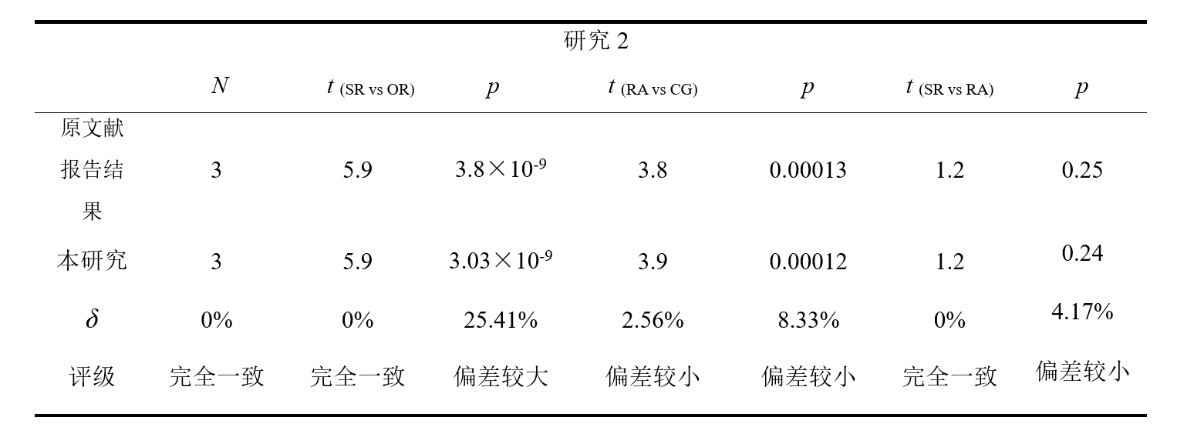
Introduction
Methods
Summary of Repeatability Results
Discussion
Conclusion
Part one
Part two
Part three
Part four
Part five
Effect of stimulus condition on aesthetic appeal
Notes:
接上，表中的内容是不同四种不同的刺激图片（自我相关图片、他人相关图片、控制图片、真实图片）对审美评级预测效果的比较。自我相关SR vs他人相关OR；真实RA vs控制CG；自我相关SR vs真实RA。原文报告的和跑出来的在P值上存在差异。

Slide 40
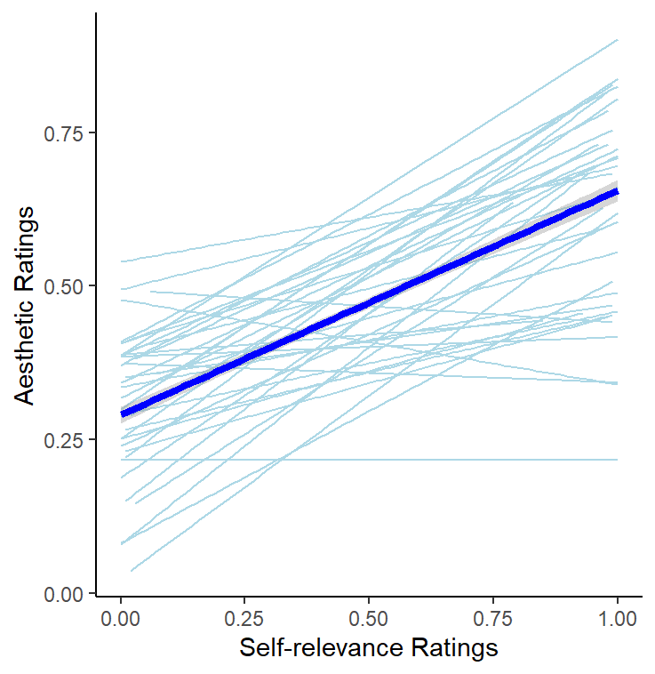
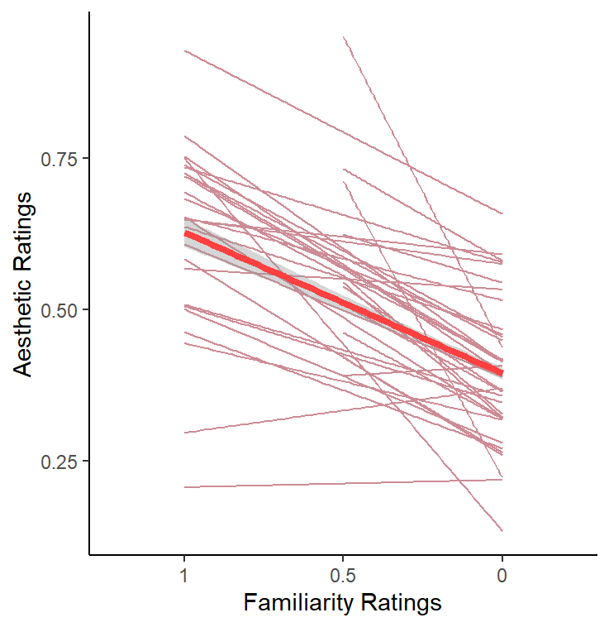
Introduction
Methods
Summary of Repeatability Results
Discussion
Conclusion
Part one
Part two
Part three
Part four
Part five
Experiment 2---Results
Notes:
自我相关性对审美吸引力有显著的正向预测作用，熟悉性对审美吸引力有显著的负向预测作用

Slide 41


Introduction
Methods
Summary of Repeatability Results
Discussion
Conclusion
Part one
Part two
Part three
Part four
Part five
Experiment 2---Results
A formal mediation analysis revealed that familiarity was able to explain only a small fraction of the self-relevance effect (Fig. 1e; average causal mediation effect = 0.04, 95% CI = [0.03, 0.05]; remaining direct effect of self-relevance on aesthetic appeal = 0.33, 95% CI = [0.30, 0.35]).
Thus, they conclude that the effect of self-relevance was not mediated by familiarity.
Notes:
熟悉性的中介作用不显著

Slide 42
Discussion
Part 4
Notes:
由

Slide 43
Introduction
Methods
Summary of Repeatability Results
Discussion
Conclusion
Part one
Part two
Part three
Part four
Part five
This study indicated that aesthetic ratings of visual art are strongly correlated with self-relevance
judgments (Experiments 1A and 1B).
High-order semantic and associative information generally matters more than low-level perceptual features for determining the aesthetic value that a person assigns to a visual image or experience.
Information about the self resides at the top of that knowledge structure, that has encoding advantage.
Given the centrality of the self-construct, it follows that acquiring information that relates to the self, and hence has the capacity to reduce uncertainty about central aspects of our world model, greater pleasure, and higher aesthetic valuation than a change in beliefs or resolution of ambiguity about a nonpersonal object or about a resolution of a perceptual ambiguity.
Notes:
在实验1A和1B中，我们发现审美吸引力和自我相关性具有很强的相关性。为什么与自我建构有关的内容更容易被体验为具有美感的内容，这可能是因为审美吸引力与信息获取之间的联系，具体来说，我们的审美体验是由高级语义和联想信息促成的，而不是仅仅感知其特征，那么这种比较高级的认知方式，可以促进相关信息增益，增加我们感受世界的确定性。另外，自我参照的记忆优势研究表明，自我构念以不同的方式组织，并依赖于独特的心理和神经过程，提及自我会带来编码优势，从而促进更加深入的加工。因此，获取于自我相关的信息，有助于获得更强的确定性，从而获得更高的审美吸引力。

Slide 44
Introduction
Methods
Summary of Repeatability Results
Discussion
Conclusion
Part one
Part two
Part three
Part four
Part five
Experiment 2 manipulated self-relevance in artworks using style transfer and examined its impact on aesthetic appeal.
Self-relevant artworks are more appealing: Customized synthetic artworks generated based on participants' responses were rated as more aesthetically appealing than artworks generated for other individuals or a control set, demonstrating the significant influence of self-relevance on aesthetic judgments.
Self-relevance is independent of image features and artistic skill: The effect of self-relevance on aesthetic appeal was not explained by intrinsic image properties or the artistic skill inherent in real artworks. This suggests that the connection between self and artwork is a distinct factor contributing to aesthetic value.
Self-relevance is not mediated by familiarity: Although familiarity positively predicted aesthetic ratings, the effect of self-relevance on aesthetic appeal was not explained by familiarity.Self-relevant content increased appeal even when the content was not specifically rated as familiar.
Notes:
自相关艺术品更具吸引力：根据参与者的反应生成的定制合成艺术品被评为比为其他个人或对照组生成的艺术品更具美学吸引力，这表明了自相关对美学判断的显著影响。
自我关联独立于图像特征和艺术技巧：自我关联对审美吸引力的影响并不能用真实艺术品固有的图像特性或艺术技巧来解释。这表明，自我和艺术品之间的联系是一个独特的因素，有助于审美价值。
自我关联不是由熟悉度中介的：尽管熟悉度对审美评分有正向预测作用，但自我关联对审美吸引力的影响并不能由熟悉度来解释。自我相关的内容增加了吸引力，即使内容没有被明确评为熟悉。

Slide 45
Introduction
Methods
Summary of Repeatability Results
Discussion
Conclusion
Part one
Part two
Part three
Part four
Part five
The reproduction of most of the data indicates that we successfully replicated the main results and trends in the experiment. However, we also observed discrepancies between a small fraction of the data and the results reported in the original study. These differences may arise from a variety of factors.
There might have been an error in the data recording process.
Differences in software versions and environment settings can also lead to slight deviations in the calculation results.
The duplicator has a vulnerability in their knowledge or operation of R.
Notes:
大部分数据的复现表明了我们能够在实验中成功地重现主要的结果和趋势。然而，我们也观察到了一小部分数据与原始研究中的结果存在差异。比如，研究1A。。。。。研究1B模型比较的P值存在一点小小的误差，研究2中。。。。。这些差异可能源自多种因素。可能是研究者在数据记录过程中出现了误差，或者是使用不同的软件版本或者设置可能会导致微小的计算差异。想不出了

Slide 46
Part 5
Conclusion

Slide 47
Introduction
Methods
Summary of Repeatability Results
Discussion
Conclusion
Part one
Part two
Part three
Part four
Part five
Conclusion
Self-relevance is a key determinant of aesthetic appeal, independent of artistic skill and image features.
Notes:
自我关联是审美吸引力的关键决定因素，独立于艺术技巧和图像特征

Slide 48
THANKS!

